Slide 1
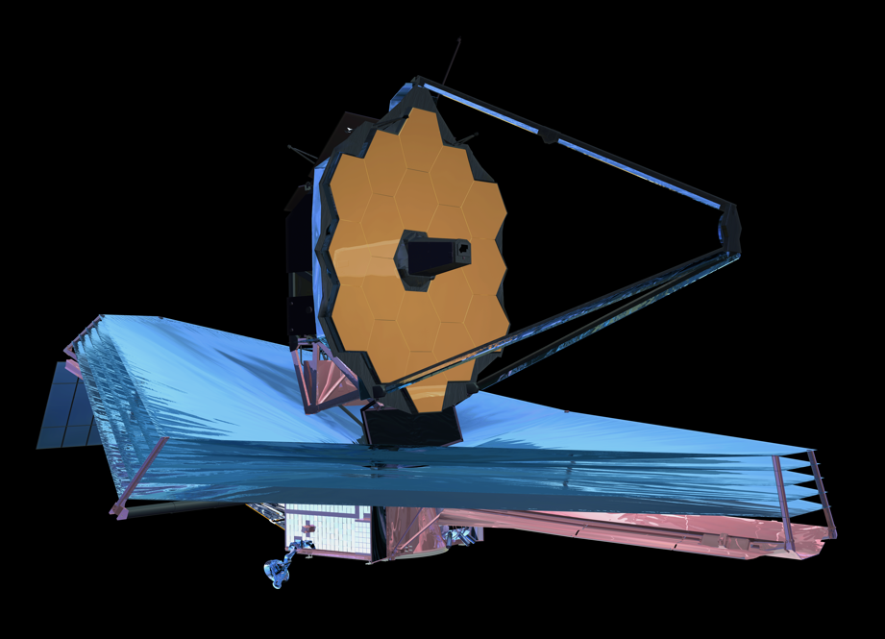
JWST Science Policies
Neill Reid –
Science Mission Office, STScI

Slide 2
Context
Our charge at STScI is to maximise the scientific return of the missions we operate
JWST epitomises international co-operation as one of the largest science programs ever undertaken, worldwide.
We (STScI and the community) need to make JWST correspondingly productive
JWST is an incredibly powerful machine with broad scientific reach and complex instrumentation, a 5-year lifetime requirement, 10-year goal
Exploiting that power requires an informed community
Providing early access to data from representative science programs is crucial to understanding JWST’s capabilities and enabling the community to maximise the science return.

Slide 3
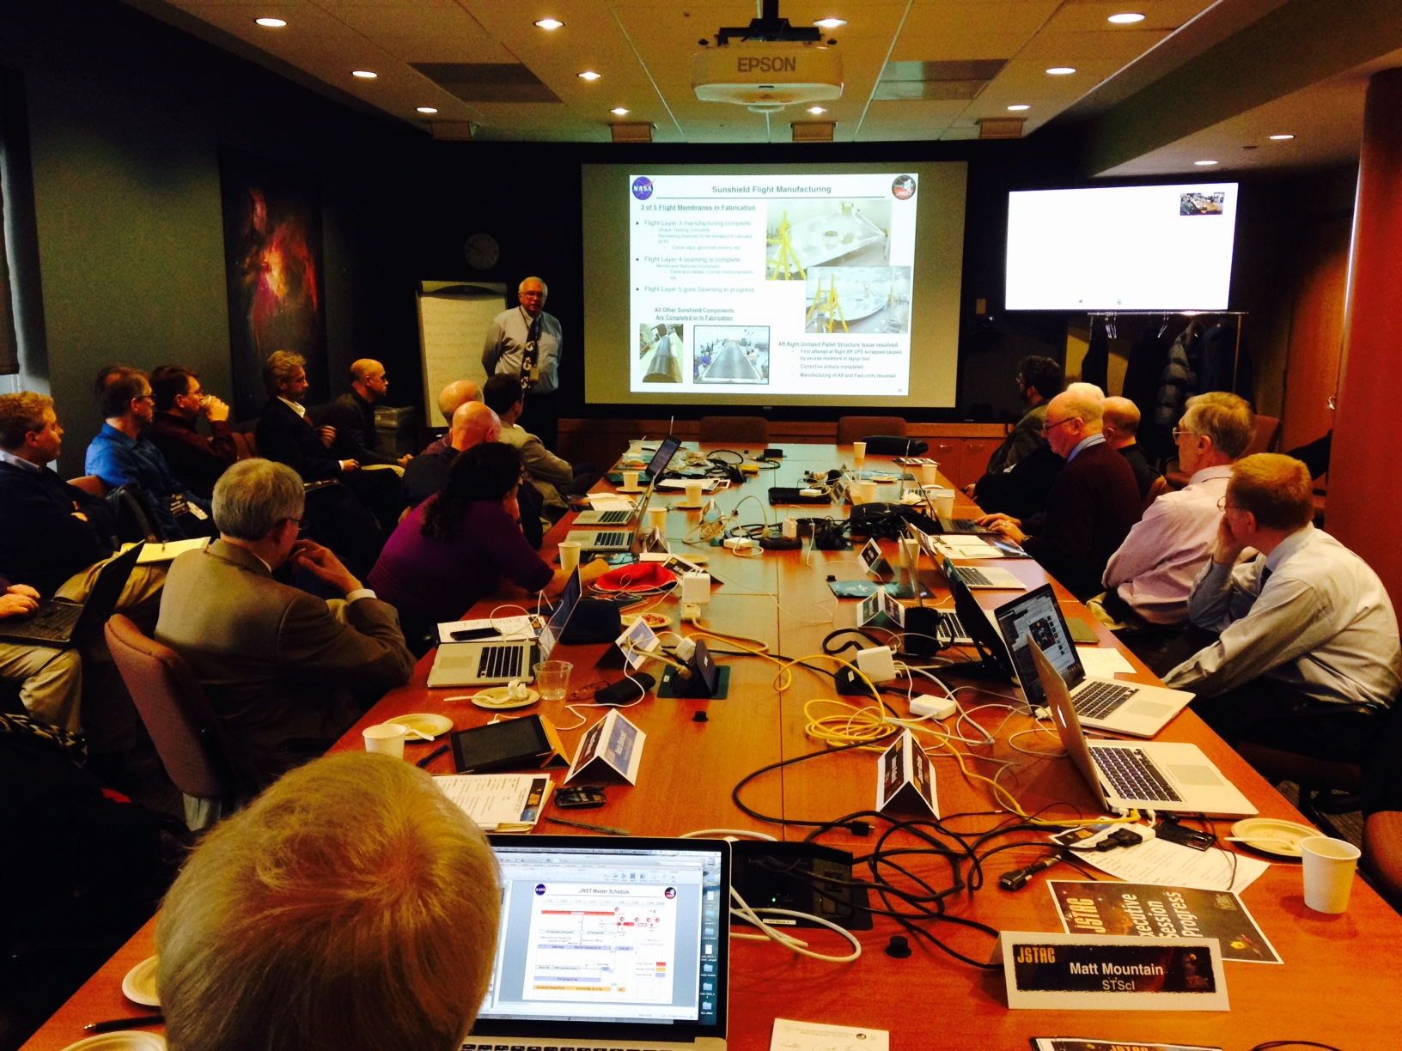
JWST Advisory Committee (est. 2009)
Roberto Abraham (Toronto)
Neta Bahcall (Princeton)
Stefi Baum (Rochester)
Roger Brissenden (Chandra/SAO)
Hashima Hasan (NASA, ex-officio)
Tim Heckman (Johns Hopkins)
Garth Illingworth (Santa Cruz, Chair)
Malcolm Longair (Cavendish)
John Mather (NASA, ex-officio)
JSTAC: advisory to STScI Director
Represents the Scientific Community
Mark McCaughrean (ESA, ex-officio)
Chris McKee (Berkeley)
Brad Peterson (Ohio State)
Alain Ouellet (CSA, ex-officio)
Joseph Rothenberg (JHR Consulting)
Sara Seager (MIT)
Eric Smith (NASA, ex-officio)
Lisa Storrie-Lombardi (Spitzer/Caltech)
Monica Tosi (Bologna)
http://www.stsci.edu/jwst/advisory-committee

Slide 4
JWST Advisory Committee (2016)
Roberto Abraham (Toronto)
Neta Bahcall (Princeton)
Tommaso Treu (UCLA)
Roger Brissenden (Chandra/SAO)
Hashima Hasan (NASA, ex-officio)
Tim Heckman (Johns Hopkins)
Garth Illingworth (Santa Cruz, Chair)
Malcolm Longair (Cavendish)
John Mather (NASA, ex-officio)
JSTAC: advisory to STScI Director
Represents the Scientific Community
Mark McCaughrean (ESA, ex-officio)
Chris McKee (Berkeley)
Kelsey Johnson (U. Virginia)
Alain Ouellet (CSA, ex-officio)
Heather Knutson (Caltech)
Natalie Batalha (Ames)
Eric Smith (NASA, ex-officio)
Lisa Storrie-Lombardi (Spitzer/Caltech)
Monica Tosi (Bologna)
http://www.stsci.edu/jwst/advisory-committee

Slide 5
Implementation
JWST (& HST) policies are implemented by the Science Policies Group @ STScI
Claus Leitherer, SPG Lead, HST TAC oversight
Brett Blacker, Technical support
Andy Fruchter, HST TAC
Janice Lee, DD-ERS, HST TAC
Jennifer Lotz, JWST documentation, HST TAC
Amaya Moro-Martín, JWST single-stream, HST TAC
Lou Strolger, Calls for proposals, HST TAC

Slide 6
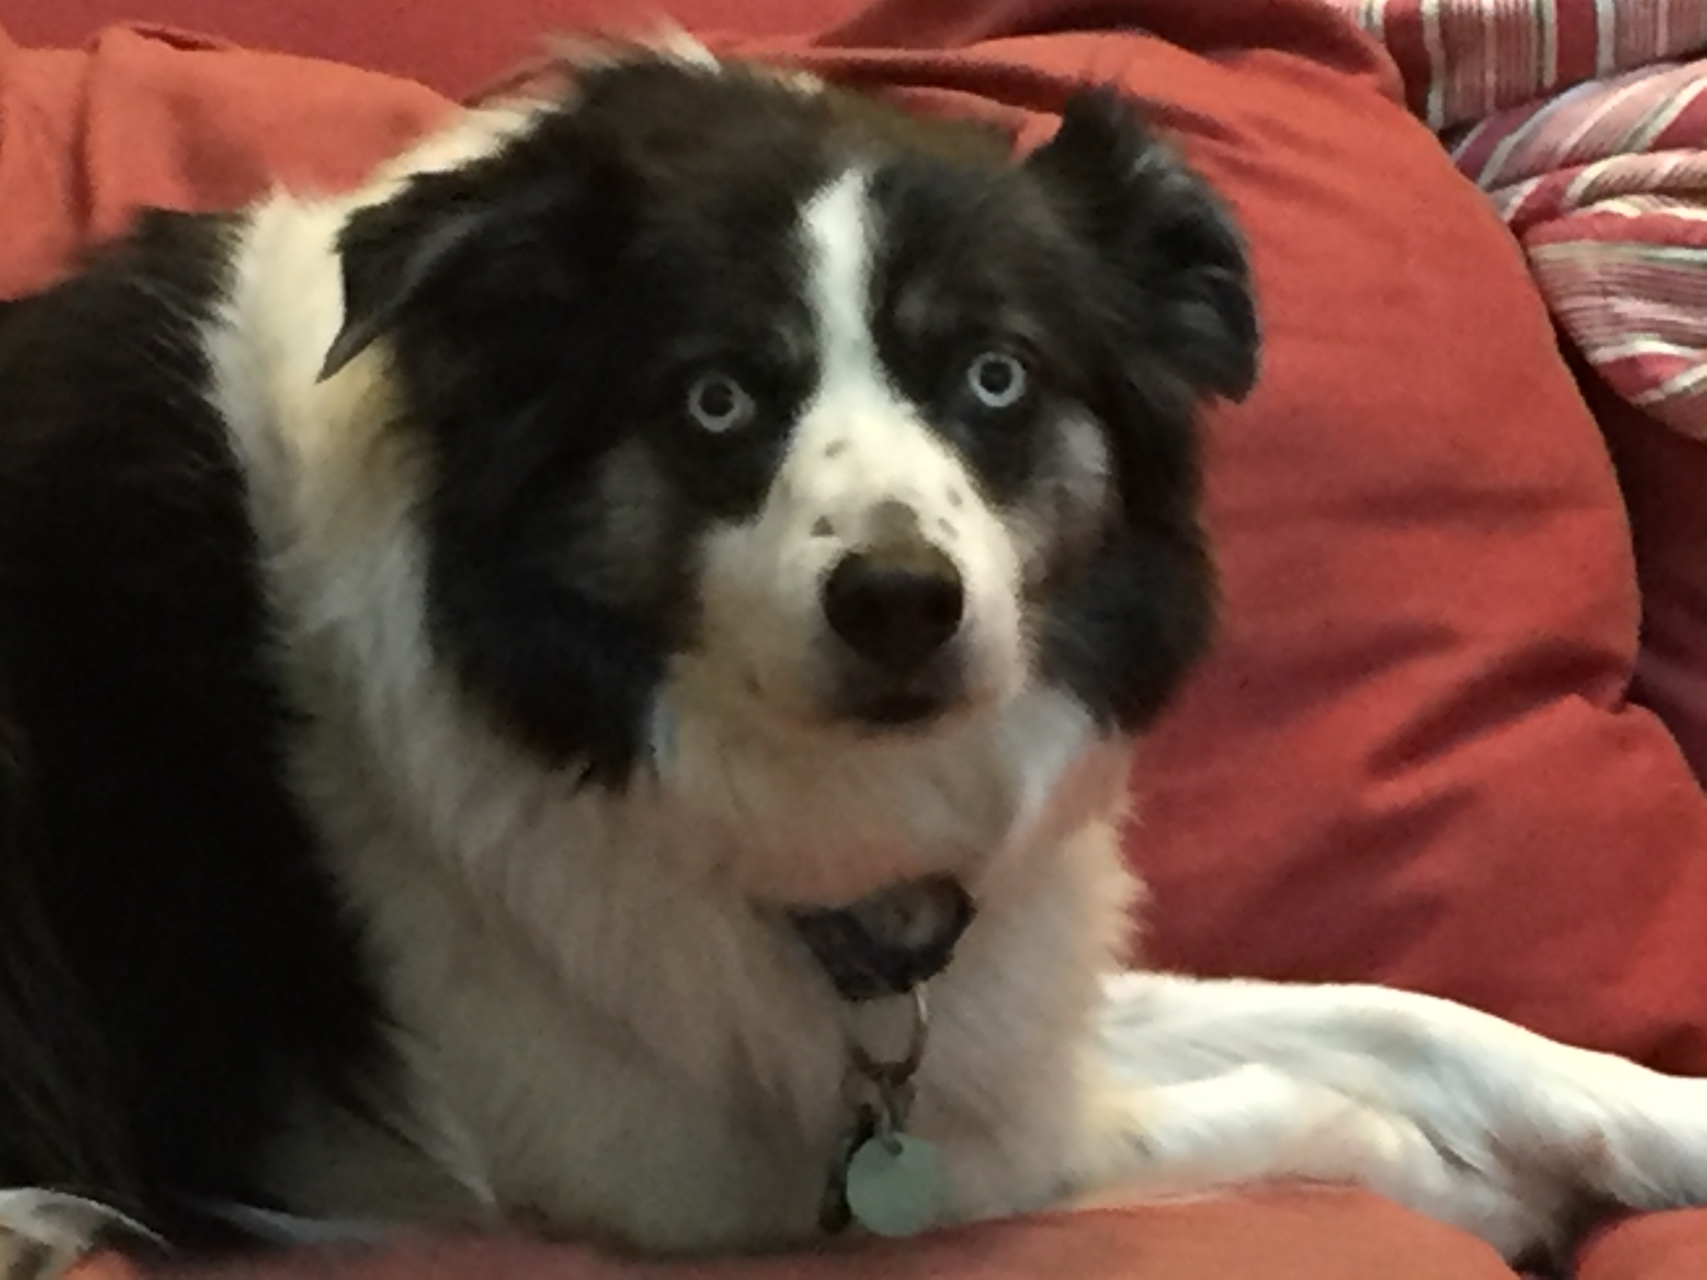
Outline
Science timeline
Schedule developments
HST & JWST in 2018
Structuring the TAC process
JWST Director’s Discretionary Early Release Science Program
Objectives and priorities
Proposal structure and format

Slide 7
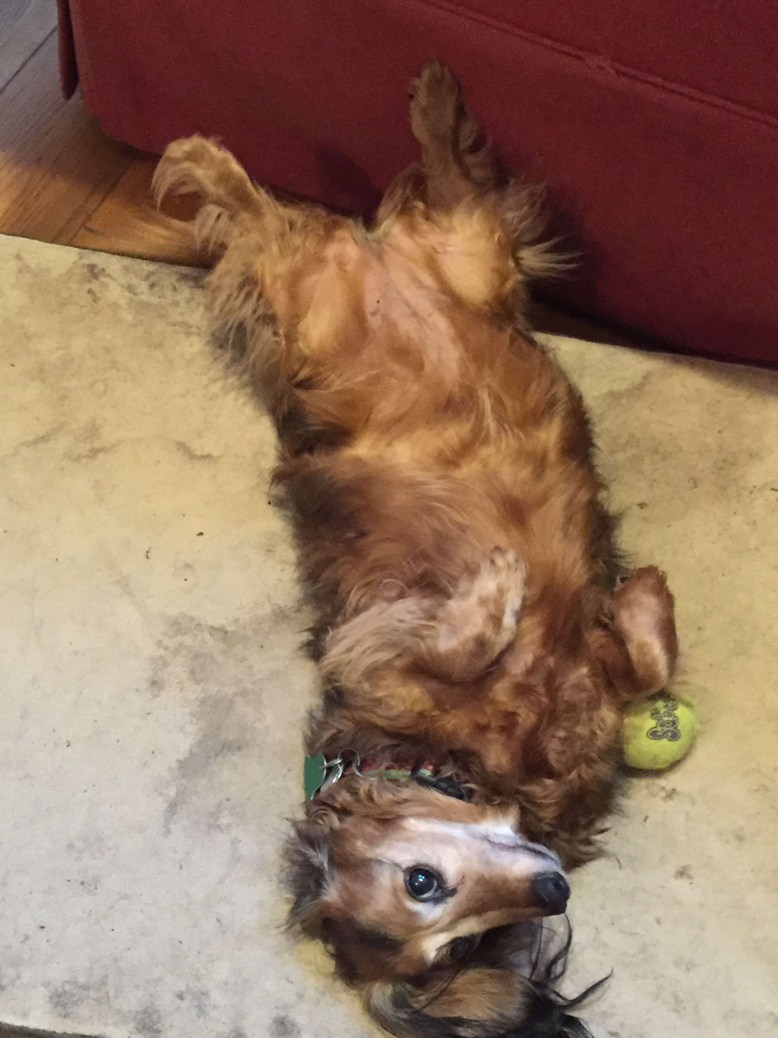
JWST Science Planning Timeline

Slide 8
Background
JWST science planning timeline outlined at several previous meetings
Review & highlight some updates
See poster #8 for full details
JWST observing programs
Guest Observer (GO programs)
Open access for the community
~80% of time in Cycles 1 through 5
Guaranteed Time Observer (GTO) programs
4020 hours allocated over first 30 months (i.e. Cycles 1 through 3)
NASA policy constraints on time/cycle
Director’s Discretionary Time (DD) programs
Up to 10%/cycle i.e. ≤877 hours
Rapid response observations & targeted science programs, such as Early Release Science program

Slide 9

JWST Science Planning Timeline
(Sept 2016)
commissioning (through 4/19)
GO CP
2017Nov30
We are here
2015
2016
2017
2018
2019
2020
2021
GTO programs have priority on specific observations of specific targets. A full list for Cycle 1 will be made available to the community no later than June 15 2017.
GTO Call
2017Jan06
launch
2018Oct
GTO Prop
deadline
2017Apr01
GTO Cy1
observations finalized
No later than June 15

Slide 10
GTO proposal submission
GTO Call issued on Jan06 2017
Includes policy information relevant for all Cycle 1 proposals
Duplications, ToO, Time-critical observations
GTO proposal submission deadline is April 1 2017
Duplication checking among GTO proposals
Duplications resolved by NASA HQ
Total time requirement
NASA policy requires Cycle 1 GTO time to comprise between 25% and 49% of the total time available to GO & GTO in Cycle 1
Corresponds to at least 1970 hours in Cycle 1
~5500 hours remain for Cycle 1 GO programs
Hubble offers ~3500 orbits (~5200 hrs) of GO science time/year
GTO Cycle 1 observation list finalised by June 15 2017
Published for the community

Slide 11
JWST Science Planning Timeline
(Sept 2016)
commissioning (through 4/19)
GO CP
2017Nov30
GO Cy1
deadline
2018Mar02
We are here
TAC
2018May
Cycle 1 science -
April 2019
GTO & GO
2015
2016
2017
2018
2019
2020
2021
GTO CP
2017Jan06
JWST Cycle 1 proposal review schedule
launch
2018Oct
GTO Prop
deadline
2017Apr01
GTO Cy1
observations finalized
No later than June 15

Slide 12
JWST GO Program Types
We anticipate that JWST GO size categories will include
Small, Medium, Large, Very Large
We anticipate a balanced distribution in program sizes over all JWST cycles
Small/Medium/Large in early cycles
The majority of time will likely be allocated to Small programs
But there will be no cap on program size
Very Large programs will be introduced in later cycles
We also anticipate specialised categories
Long-term programs → Regular/Medium programs whose science requires observations in future cycles (astrometry, variability)
ToO programs
Treasury/Legacy programs → large-scale programs with broad science reach and emphasis on providing higher-level data products for the community
Joint programs with other facilities will not be available until Cycle 2
JWST will offer limited coordinated science parallels in Cycle 1
Pure parallel GO programs will be also available
JWST will also accept proposals for archival & theory research programs
STScI is continuing to refine these concepts in consultation with the JSTAC.

Slide 13
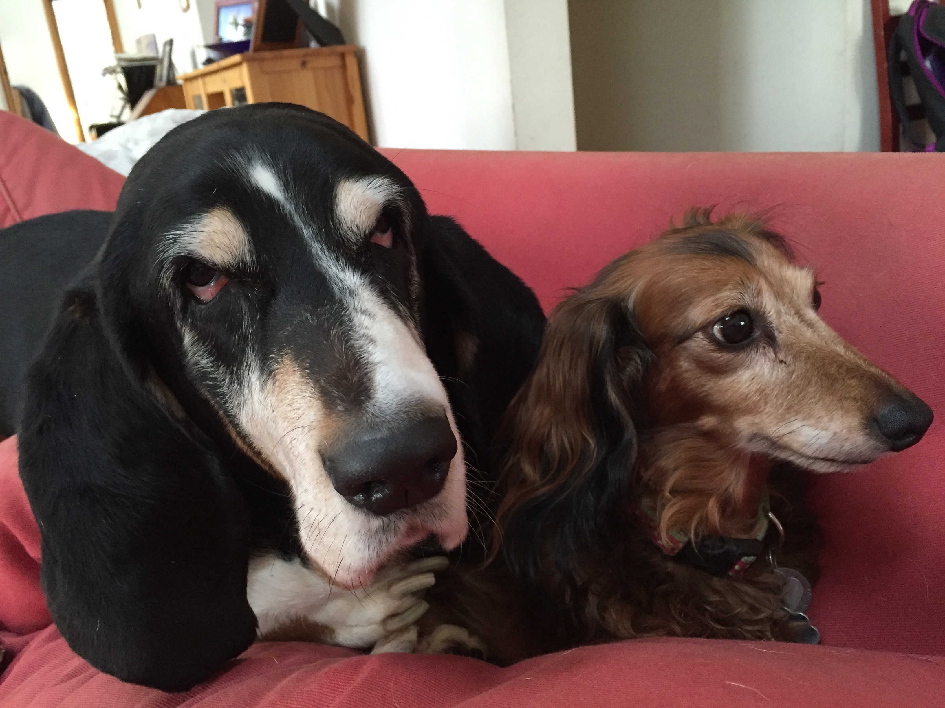
JWST and HST

Slide 14
HST & JWST in 2018: Baseline schedules
HST
Cy25 deadline
4/2017
Cy26 deadline
4/2018
Cy27 deadline
4/2019
Cy28 deadline
4/2020
TAC
6/17
TAC
6/18
TAC
6/19
TAC
6/20
2016
2017
2018
2019
2020
TAC
5/2018
GO Cy1
deadline
2/2018
GO Cy2 deadline
12/2019
TAC
2/2020
JWST
launch
2018Oct

Slide 15
Restructuring HST Cycles 25 & 26
Minimise HST activities in 2018 ➔ reduce the overall workload in that year for the community and for STScI
Pre-allocate Cycle 26 orbits @ Cycle 25 TAC
Allocate ~4600 orbits @ 2017 Cycle 25 TAC
Orbit allocation for each panel increased by 50%
All proposals selected must be deemed worthy of HST time
Panels consistently indicate they are willing to select twice as many programs as they have orbits to support
Retain ~600 orbits for 3-4 mid-cycle opportunities
Limited to proposals for <10 orbits
Allocate ~1100-1200 orbits at Cycle 26 ∆ TAC in 9/2018
Limited to medium and large proposals
Focus on supplementing accepted JWST Cycle 1 programs
Revert to current HST schedule in 2019 (Cycle 27)

Slide 16
Restructured schedules: HST Cycles 25 & 26
HST
Cy25 deadline
4/2017
Cy26 ∆TAC deadline
7/2018
Cy27 deadline
4/2019
Cy28 deadline
4/2020
TAC
6/17
∆TAC
9/18
TAC
6/19
TAC
6/20
2016
2017
2018
2019
2020
Call
11/2017
TAC
5/2018
GO Cy1
deadline
3/2018
GO Cy2 deadline
12/2019
TAC
2/2020
JWST
launch
2018Oct

Slide 17
HST: Mid-cycle opportunities
HST
Cy25 deadline
4/2017
Cy26 ∆TAC deadline
7/2018
Cy27 deadline
4/2019
Cy28 deadline
4/2020
TAC
6/17
∆TAC
9/18
TAC
6/19
TAC
6/20
2016
2017
2018
2019
2020
25#1
10/17
25#2
2/18
26#1
10/18
26#1
2/19
Anticipate significant number of JWST-related proposals
Mid-cycle

Slide 18
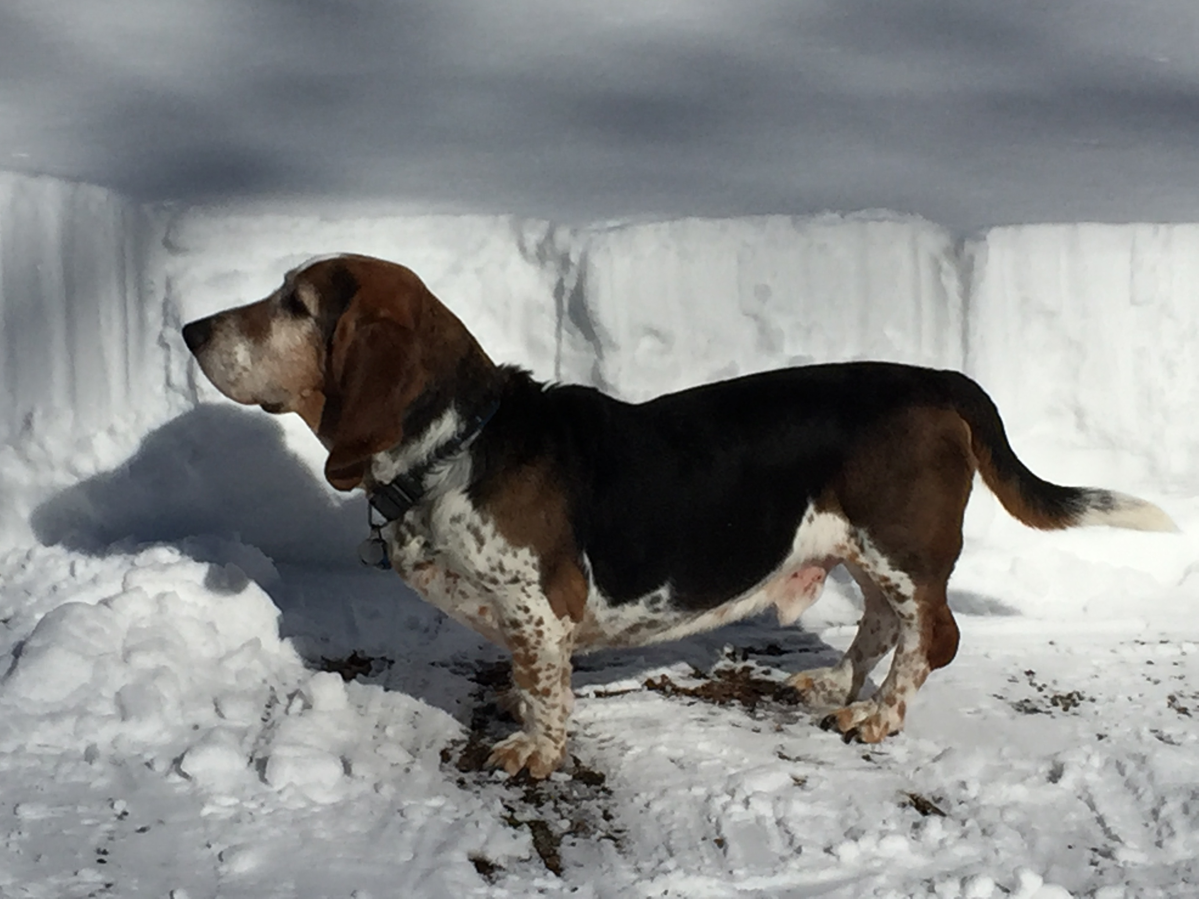
JWST and data access The DD-ERS program

Slide 19
Cycle 2 proposal schedule
JWST science observations start in April 2019
Cycle 2 CP in September 2019, ~5 months into Cycle 1
Cycle 2 proposal deadline in early December 2019, ~7.5 months from the start of Cycle 1
The general community will have very limited access to non-proprietary observations to aid preparations for Cycle 2 programs
commissioning (through 4/19)
2018
2019
2020
launch
2018Oct
GO Cy2 CP
2019Sep
GO Cy2
deadline
2019Dec
Cycle 2 science –
April 2020
GTO & GO
GO Cy2
TAC
2020Feb

Slide 20
Enabling data access
The JWST Advisory Committee recommended implementation of an Early Release Science Program
“..to obtain images and spectra that would be used to demonstrate key modes of the JWST instruments. The goal of this program is to enable the community to understand the performance of JWST prior to the submission of the first post-launch Cycle 2 proposals that will be submitted just months after the end of commissioning.” (see JSTAC letters 21/6/2010 & 26/3/2014)
Concept: A suite of science demonstration observing programs, designed by the community and selected through proposal peer review :
Director’s Discretionary Time
Data have no exclusive access period
Programs selected by peer review prior to Cycle 1 GO Call
The DD-ERS program represents science from the community selected by the community for the community

Slide 21
DD-ERS & Cycle 1 GTO/GO schedules
ERS NoI due 2017Mar03
ERS TAC 2017Oct
GO CP
2017Nov30
GO Cy1
deadline
2018Mar02
ERS Call 2017Apr01
Call for DD-ERS Notices of Intent ERS draft call
2017Jan06
commissioning
(6 mo)
ERS
deadline
2017Aug18
GO TAC
2018May
2016
2017
2018
2019
launch
2018Oct
Cycle 1 obs. begin
2019Apr
GTO
props due
2017Apr01
Detailed schedule subject to change
GTO Cy1
observations
reserved
2017Jun15
JWST Science Timeline
2016Sept

Slide 22
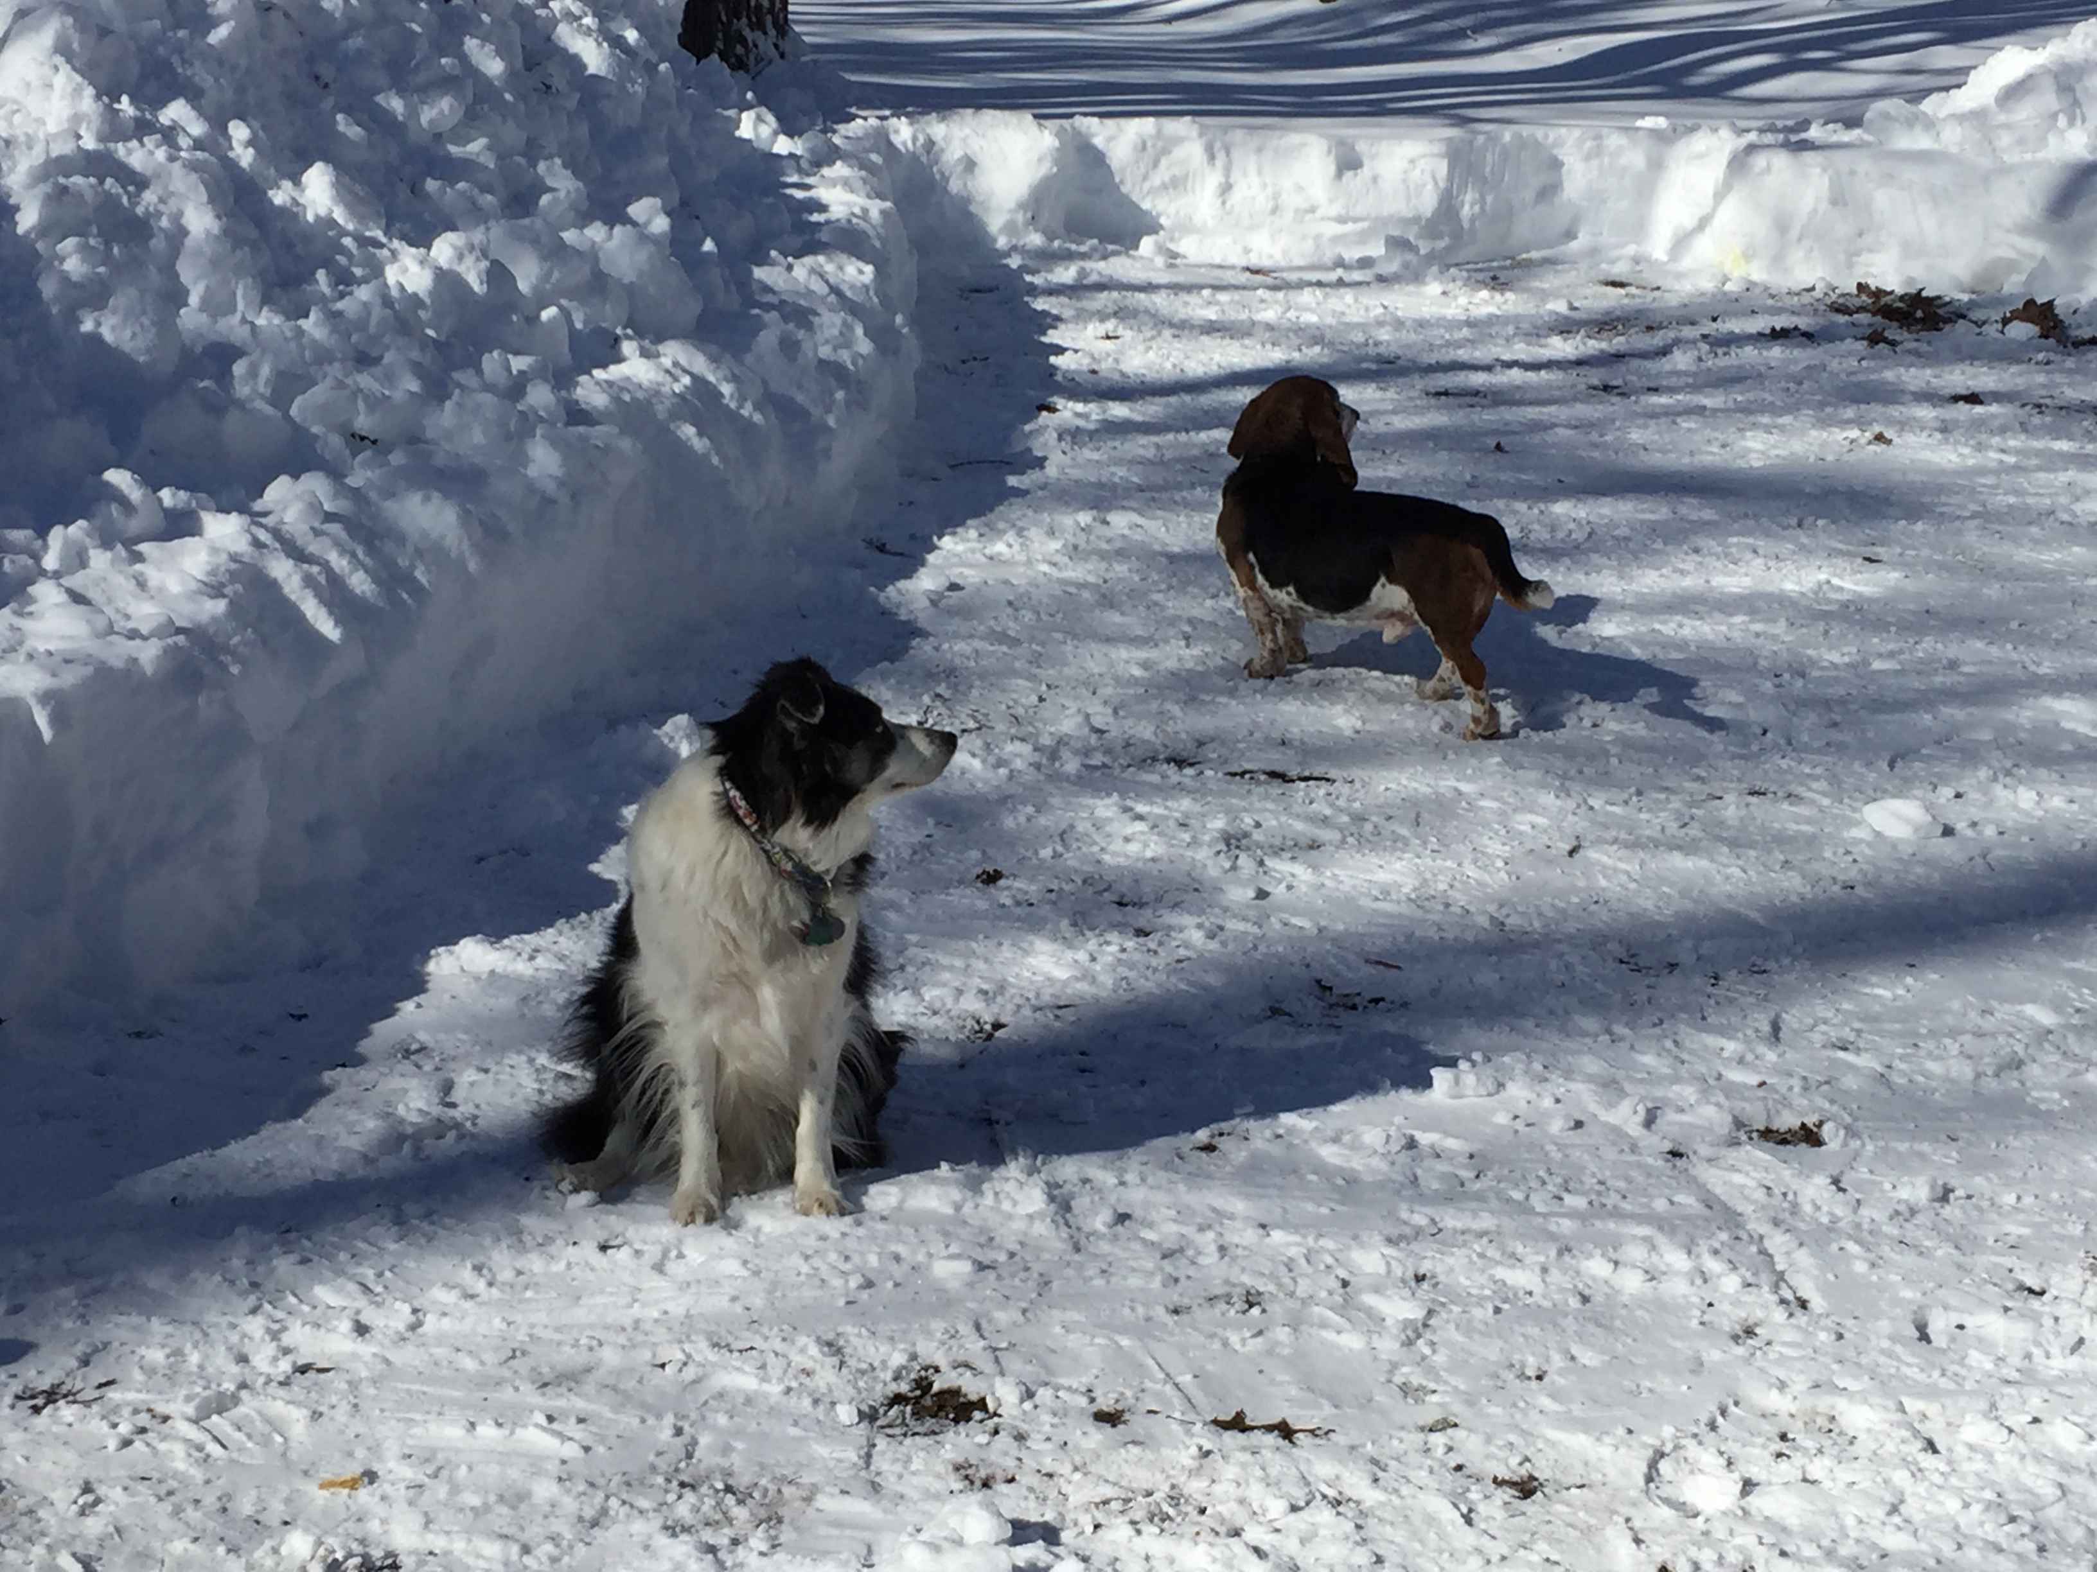
What distinguishes a DD-ERS proposal from a Cycle 1 GO proposal?

Slide 23
Selecting DD-ERS programs
TAC reviews focus almost exclusively on science
Reviewers are tasked with selecting the most compelling science
The prime focus of the DD-ERS program is preparing the community to maximise JWST’s scientific productivity in Cycle 2 and beyond
Reviewers will select programs based on additional criteria beyond compelling science, including breadth of community science facilitated, value of proposed team products, community involvement in the program design
ERS proposals have an altruistic element
How will you help your colleagues exploit JWST?

Slide 24
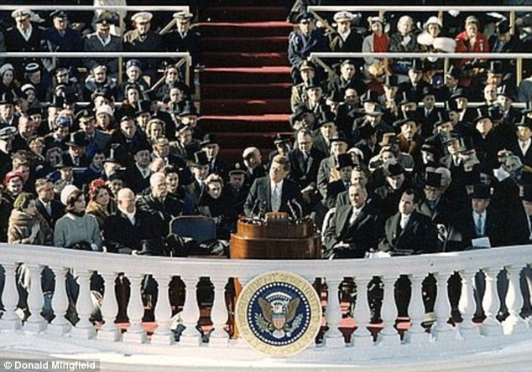
Observations
Ask not what JWST can do for you;
ask what you can do for JWST.
JWST will be at L2
Continuous observations (in principle) analogous to Spitzer rather than Hubble
Observing programs will be allocated wall-clock time
Overheads incorporated in the allocation
8,766 hours available per year
5,000 to 6,000 hours on-target integration time

Slide 25
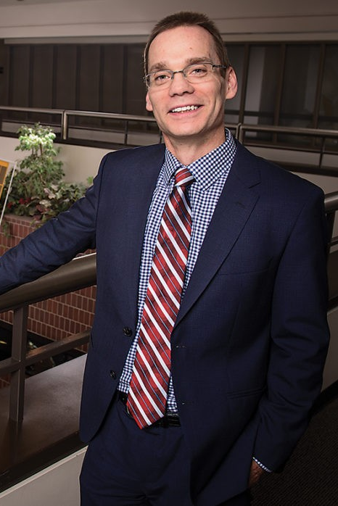

STScI Director Ken Sembach will allocate ~500 hours of Director’s Discretionary time for an Early Release Science (DD-ERS) program to prepare the community for Cycle 2
Resources are allocated to support up to 15 teams. Proposals will be selected in research areas spanning the science themes of JWST :
A multi-disciplinary committee of experts will recommend a suite of proposals that both fulfills the goals of the DD-ERS and makes optimal use of the available time for observation and funding.

Slide 26
How are DD-ERS programs distinguished from standard GO programs?
DD-ERS programs will enable the community to learn to exploit the science capabilities of JWST early in its mission. Selected programs will:
be substantive science demonstration programs providing representative datasets of broad interest to researchers in major astrophysical sub-disciplines. Coherent investigations using multiple observing modes are valued, though not required.
be formulated by teams with diverse representation in expertise and demographics of community members in a given major sub-discipline, to help ensure that the observations will be of broad interest to that community.
design, create, and deliver science-enabling products to help the community learn to observe effectively with JWST and analyze its data. Each project must define a core team to be responsible for the timely delivery of such products according to a proposed workplan.

Slide 27
How are DD-ERS programs distinguished from standard GO programs? (continued)
Observations must be schedulable within the first 4-5 months of Cycle 1, and target lists must be flexible to accommodate possible changes to the scheduled start of science observations.
Both raw and pipeline-processed data will enter the public domain immediately after processing and validation at STScI; i.e. these data will have no proprietary time.
DD-ERS programs are pathfinders for the community
Beyond providing early access to JWST data, these programs will
Accelerate the diffusion through the community of direct knowledge of JWST’s capabilities
Expand early opportunities for hands-on experience in the reduction and analysis of JWST data

Slide 28
GTO CP release
Jan06
GO Cy 1 CP
Nov30
GTO Cy1
obs release
by Jun15
GO Cy1
props due
Mar02
GTO
props due
Apr01
commissioning
(6 mo)
cycle 1
Obs
begin
Apr
GO Cy1
TAC May
2017
2018
2019
launch
2018Oct
JWST Science Timeline
September2016

Slide 29
GTO CP release
Jan06
GO Cy 1 CP
Nov30
GTO Cy1
obs release
by Jun15
GO Cy1
props due
Mar02
GTO
props due
Apr01
commissioning
(6 mo)
cycle 1
Obs
begin
Apr
GO Cy1
TAC May
2017
2018
2019
DD-ERS
TAC Oct
DD-ERS initial CP release
Jan06
DD-ERS
props due Aug18
launch
2018Oct
DD-ERS final
CP release
May19
DD-ERS Notices
of Intent
due Mar03
JWST Science Timeline
September2016

Slide 30
DD-ERS proposal requirements (not your standard GO proposal…)
Mandatory Notice of Intent to Propose (due 2017Mar03)
Enables STScI to identify community members for review (appropriate expertise, w/o conflict).
NoI material is confidential.
NoI requirements:
project title,
brief (~few paragraphs) description of proposed science project, including JWST instruments and modes to be used, to best of proposing team’s knowledge at time of NoI submission,
name(s) and affiliation(s) of the PI (or co-PIs),
name(s) and affiliation(s) for as many Co-Is as are known at time of NOI submission.
brief description of how proposing team broadly represents relevant experts and demographics of sub-discipline.

Slide 31
DD-ERS proposal requirements (not your standard GO proposal…)
Justification for ERS time
How will your program help the community learn to do science with JWST and prepare for Cy2? What science-enabling products are proposed for development and release? How will your program demonstrate baseline JW science capabilities?
2. Project Management Plan & Budget
Data processing and analysis plan, roles, responsibilities, work schedule, budget. Identification of core team responsible for science-enabling product development and delivery.
3. Scientific Justification
Why are the observations scientifically compelling and require JWST?.
4. Description of the Observations
Establish feasibility for early execution, and flexibility in target selection to accommodate any change to start date for Cy1 science obs.
5. Team Diversity
Description of how the proposing team represents and has input from diversity of experts with broad demographics within sub-discipline

Slide 32
DD-ERS selection criteria (not your standard GO proposal…)
Facilitation of community understanding of JWST science capabilities
Value of proposed science-enabling products
Credibility of work and management plan
Scientific merit & demonstration that JWST capabilities are required
Technical merit, feasibility for early execution, target selection flexibility
Full details to be provided in the DD-ERS Call for Proposals (Jan2017).

Slide 33
DD-ERS Data Products
Examples
1. Participation in community briefings organized by STScI
written/oral updates on progress
written/oral documentation of lessons-learned
2. Software with documentation
data analysis and modeling
enhanced data processing
3. Enhanced data products with documentation
aligned multiband images, extracted spectra, etc
catalogs
Building blocks for GO programs
APT files available at Cy1 CP release
Enables Cy1 archival programs
Provides kernels for cohesive science-based training sets
Observation & proposal planning
Data reduction and analysis cookbooks

Slide 34
In addition to immediate release of data, ERS activities provide focal point for organization of GO user support,
and dissemination of information on JWST performance and results.
Accelerates the dispersion of expertise in observing with JWST through the community to maximise the science return within 5-yr required, 10-yr anticipated lifetime.

Slide 35



Slide 36
ers
team
ers
team
ers
team

Slide 37

GTO CP release
Jan06
GO Cy 1 CP
Nov30
GTO Cy1
obs release
by Jun15
GO Cy1
props due
Mar02
GTO
props due
Apr01
commissioning
(6 mo)
cycle 1
Obs
begin
Apr
GO Cy1
TAC May
2017
2018
2019
DD-ERS
TAC Oct
DD-ERS initial CP release
Jan06
DD-ERS
props due Aug18
launch
2018Oct
DD-ERS final
CP release
May19
More info
on timeline
and DD-ERS
coming soon:
DD-ERS Notices
of Intent
due Mar03
October 2016 Special Issue
JWST Proposal Planning

Slide 38
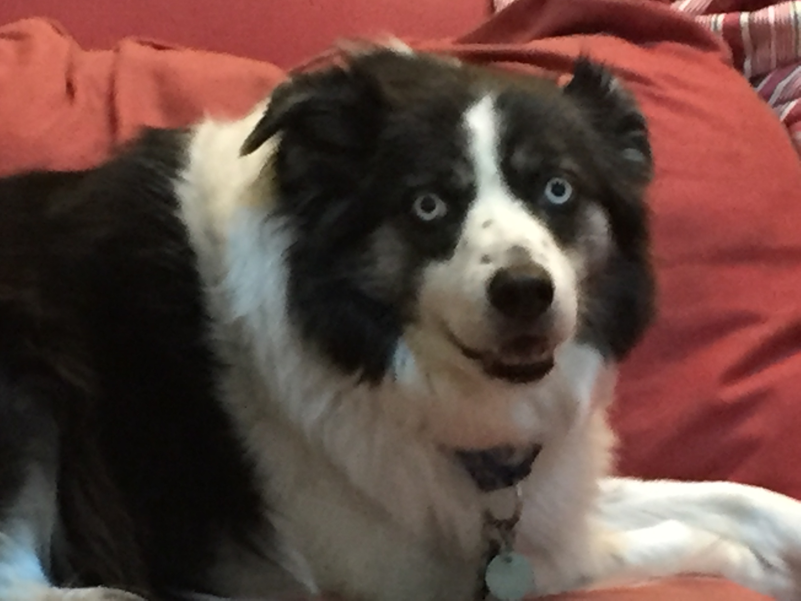
Summary
We continue to refine the science planning timeline for JWST
GTO Cycle 1 Call issued on Jan 6 2017
GTO Cycle 1 observations published by June 15 2017
GO Cycle 1 Call issued on November 30 2017
GO Cycle 1 proposal deadline on March 2 2018
We have defined a framework for the DD Early Release Science program
500 hours of DD time available for 12-15 science programs
The goal is preparing the community to maximise JWST’s scientific productivity in Cycle 2 and beyond
DD-ERS draft call issued with call for Notices of Intent on Jan 6 2017
DD-ERS proposal deadline on August 18 2017
The HST proposal timeline has been restructured to support and complement the JWST Cycle 1 timeline

Slide 39
DD-ERS & Cycle 1 GTO/GO schedules
DD-ERS NoI due 2017Mar03
DD-ERS TAC 2017Oct
GO CP
2017Nov30
GO Cy1
deadline
2018Mar02
Call for DD-ERS Notices of Intent ERS draft call
2017Jan06
ERS Call 2017Apr01
commissioning
(6 mo)
DD-ERS
deadline
2017Aug18
GO TAC
2018May
2016
2017
2018
2019
GTO Call
2017Jan06
launch
2018Oct
GTO APT
submissions
2017Sept01
Cycle 1 obs. begin
2019Apr
GTO
props due
2017Apr01
GTO Cy1
observations
published
2017Jun15
JWST Science Timeline
2016Sept

Slide 40
Backup slides

Slide 41
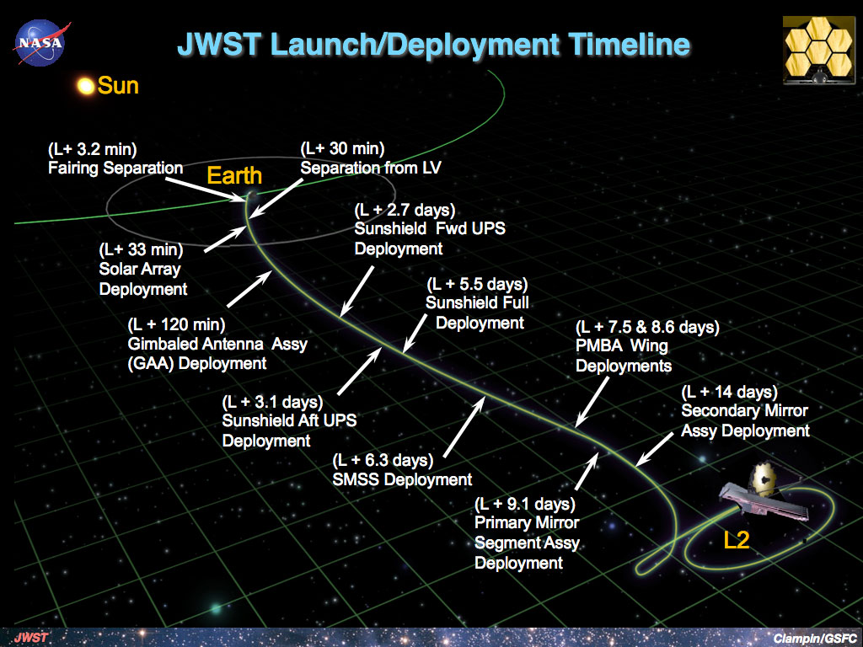
Classes of Observations
Commissioning [6 mo: 2018 Oct-2019 Apr]
- full schedule of deployment & check-out activities
- limited set of science calibration obs possible
- science obs highly unlikely
At L2 after ~1mo, turn on/check-out
- FGS/NIRISS
- NIRCam
- NIRSpec
- MIRI
phase mirrors, etc.

